Slide 1

TASK TANGO
- FANTASTIC 5

Slide 2
Agenda
INTRODUCTION
PROBLEM STATEMENT
SOLUTION OVERVIEW
FEATURES
TECHNICAL DETAILS
BENEFITS
CONCLUSION

Slide 3

Introduction
“Are you tired of feeling overwhelmed and disorganized? Do you struggle to keep track of your tasks, appointments, and deadlines ?
In today’s world, staying organized and focused is crucial for success. That’s why we’ve developed the Daily Planner and Reminder Bot – a revolutionary Al-powered tool designed to help you:
Boost your productivity and efficiency
Reduce stress and anxiety
Achieve your goals and aspirations

Slide 4

PROBLEM STATEMENT
Many individuals often struggle with managing their time efficiently and remembering important tasks and events. This leads to missed deadlines, forgotten appointments, and increased stress. Existing tools are either complex to use, lack customization, or fail to fullfill our daily routines

Slide 5

SOLUTION OVERVIEW
Our TASK TANGO is an Al-powered solution designed to:
Streamline your task management
Enhance your productivity Reduce stress and anxiety Improve your work-life balance
With our bot, you can:
Create and manage your daily schedule Set reminders and notifications Prioritize tasks and break them down Integrate with your calendar and email

Slide 6
KEY FEATURES:
Daily Scheduling: Create and manage your daily schedule with ease Reminders and Notifications: Set reminders and notifications for upcoming events and deadlines Task Prioritization: Prioritize tasks and break them down into manageable chunks Calendar Integration: Integrate with your calendar and email for seamless synchronization Customizable: Customize the bot to fit your needs and preferences.

Slide 7




TECHNICAL DETAILS:
Built using: Python, JavaScript, and HTML/CSS.
Integrates with: Google Calendar, Microsoft Outlook, and other popular calendar APIs.
Device compatibility: Accessible on desktop, tablet, and mobile devices.

Slide 8
BENEFITS:
Increased Productivity: Streamline your task management and stay focused on what matters Improved Organization: Keep your schedule and reminders in one place, easily accessible Reduced Stress: Feel more in control and calm, with reminders and notifications to keep you on track Enhanced Goal Achievement: Set and achieve your goals with personalized recommendations and suggestions Better Work-Life Balance: Manage your personal and professional life with ease, and make time for what’s important Customized Experience: Tailored to your needs and preferences, for a unique and effective experience Scalability and Flexibility: Accessible on desktop, tablet, and mobile devices, and integratable with your existing tool

Slide 9
CONCLUSION
The Daily Planner and Reminder Bot is a game-changing task management solution that harnesses the power of Al to streamline your schedule and reminders. With its personalized approach, the bot helps you stay focused, productive, and organized, learning your habits and preferences to provide tailored suggestions and recommendations. Don’t let task management hold you back – try the Daily Planner and Reminder Bot today and experience the benefits of Al-powered productivity! Join the productivity revolution and unlock a more efficient, effective, and stress-free you! Visit our website to learn more and discover how the bot can transform your workflow.

Slide 10
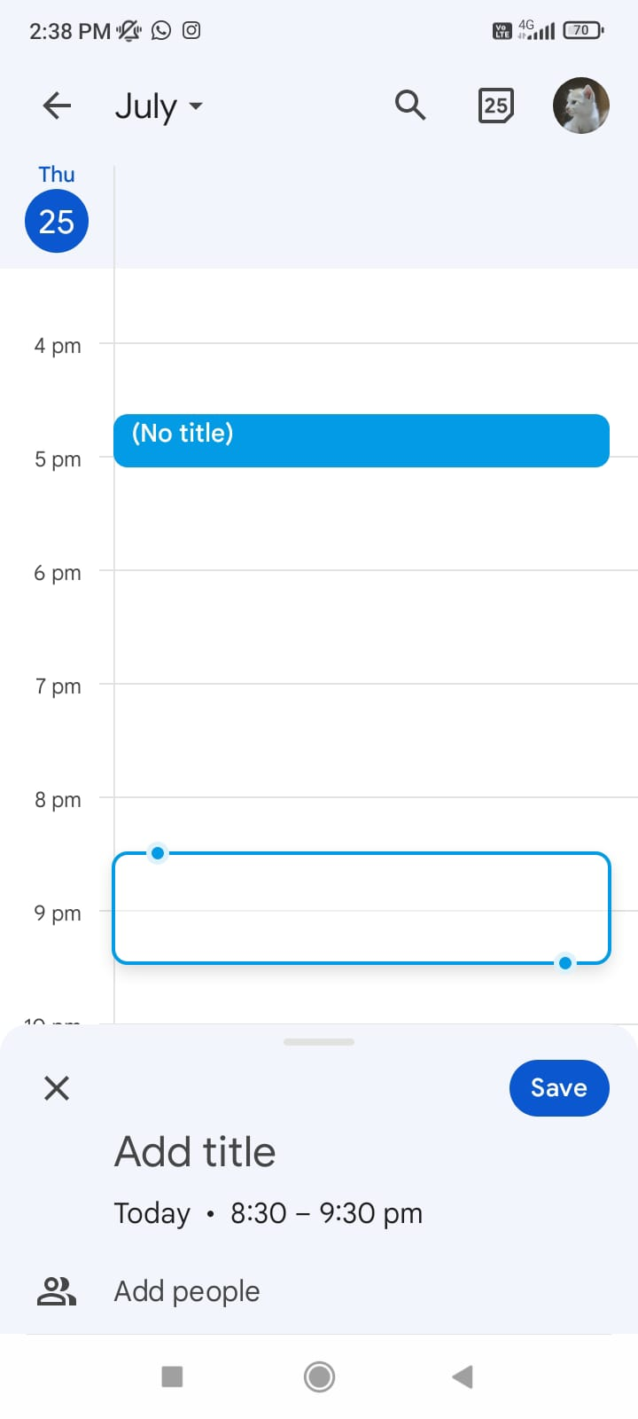
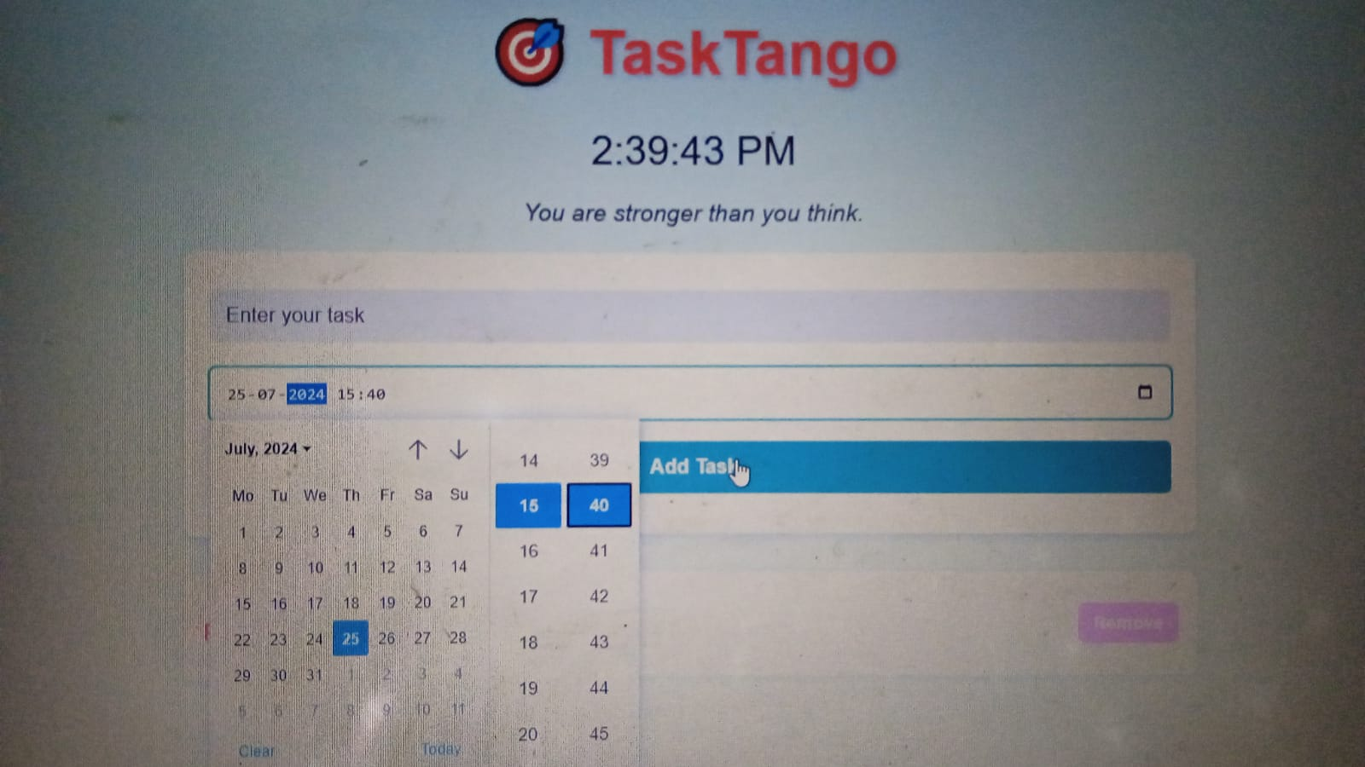
Why TASK TANGO IS BETTER ?

Slide 11
THANK YOU

